Slide 1
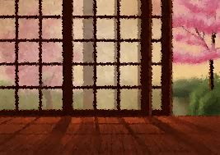
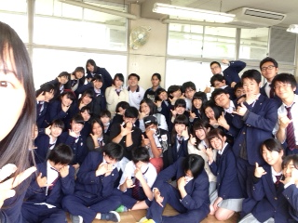
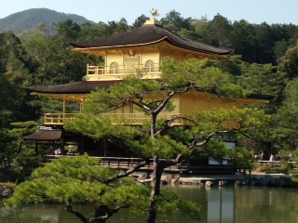
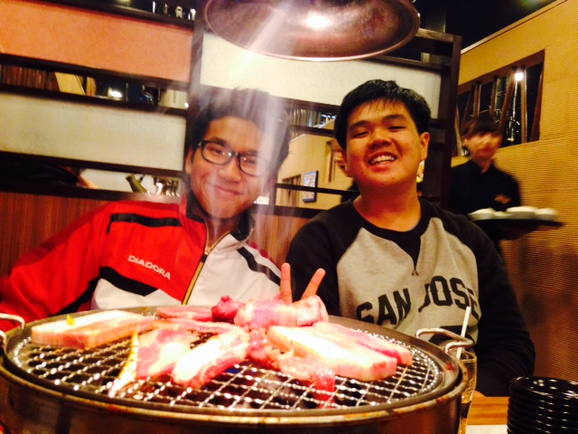
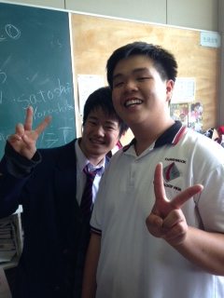
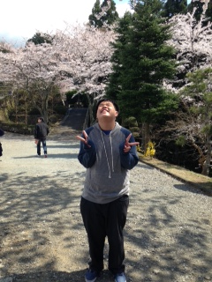
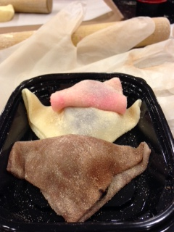
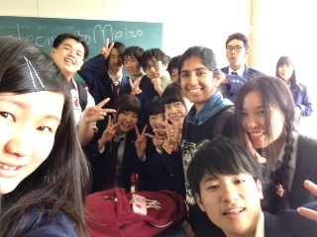
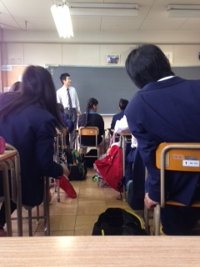
Japan Trip 2014
Marcus Lee

Slide 2


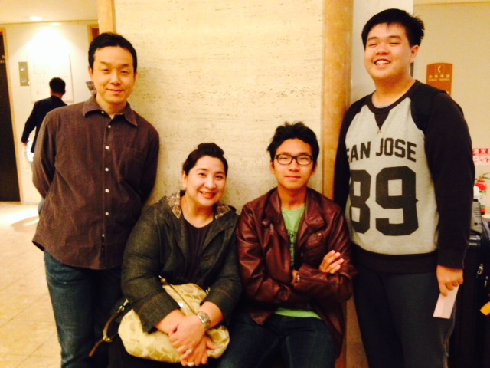
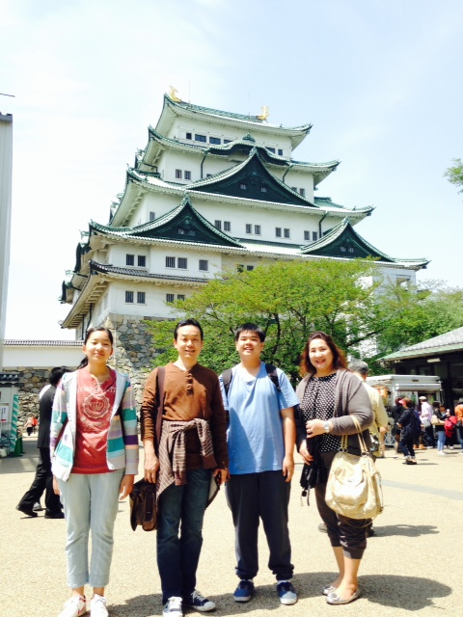
Host Family 国田
My Family
お父さん
お母さん
Father
Mother
拳くん(お兄さん）
里奈さん（妹）
Me (Marcus)
Younger Brother (Enric)

Slide 3

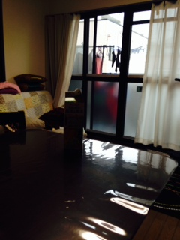
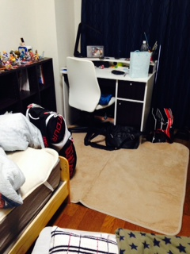
バ
ル
コ
ニ
台所
拳くんの部屋
ダイニングルーム
テレビ
里奈さんの部屋
居間
お父さんとお母さんの部屋
お風呂場
トイレ
玄関
日本で住んでいる所はとても狭いですけど、居心地がいいです。玄関の左側はトイレとお風呂場で、前には拳くんと里奈さんの寝室です。左に曲がって、台所は右側にあって、前には居間とダイニングルームです。居間の隣はお父さんとお母さんの寝室です。バルコニもあります。そこから、外の景色が見えます。

Slide 4
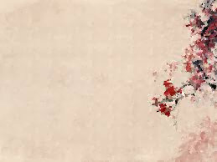
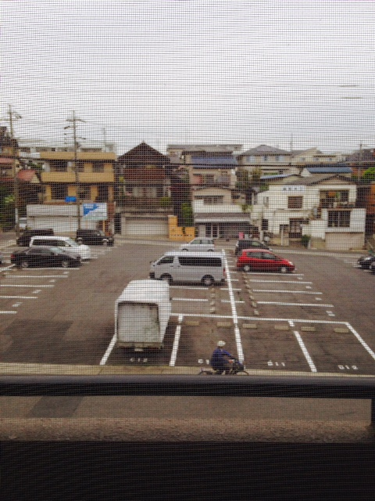
My host family lives in the Meito-ward (名東区）and an area called Hoshigaoka （星ヶ丘）. It is a quiet area with a variety of apartments and terrace houses. Although it seems like families do own cars, bicycle seems to be quite a popular mean of transport around the neighbourhood. There is a local shopping centre called Daiei , three minutes by foot away from my host family’s apartment. There is also a station called Hoshigaoka Station conveniently located near the area, as well as bus stations found throughout the neighbourhood.

Slide 5
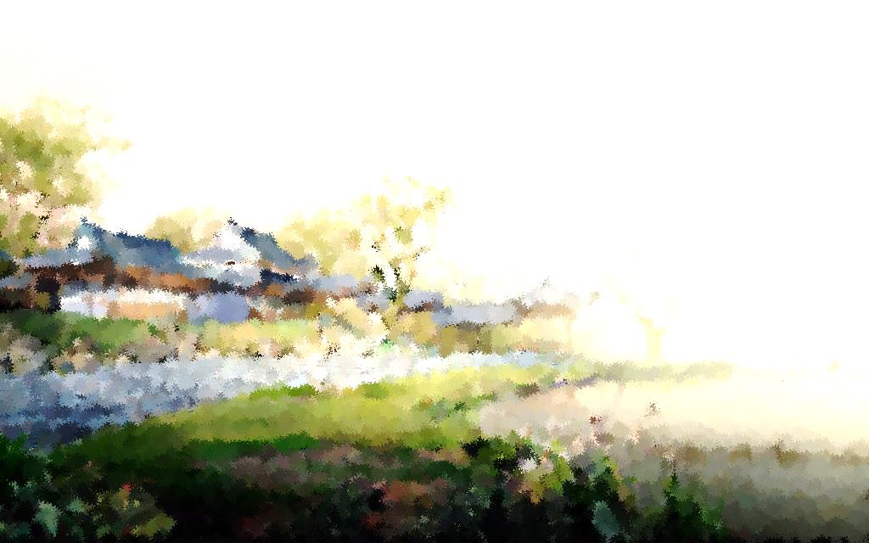
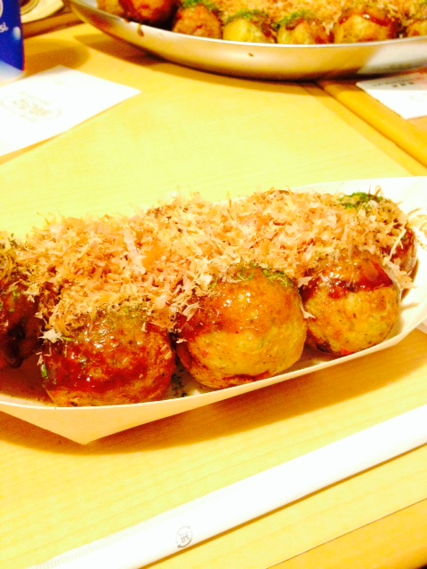
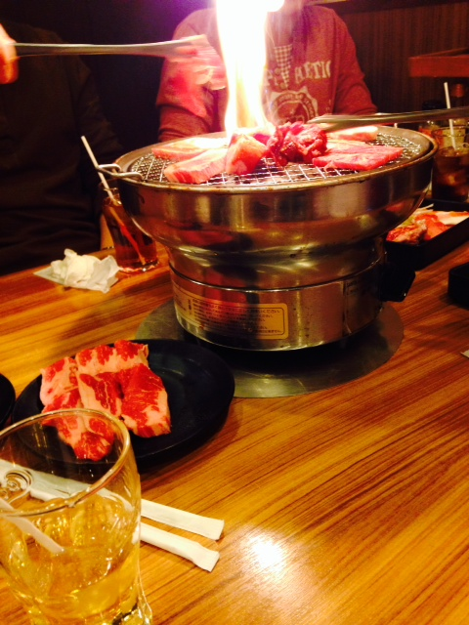
As my host family is half-Thai, the food that I’ve eaten with my host family was varied. For breakfast we usually have simple bread./buns with juice and fruits. During school days, lunch is usually お弁当、a lunch box with rice and other side dishes, which I had chicken and salad. The lunch that my family eats on a normal day is usually fried rice or noodles, but not as heavy as what we have for dinner. For lunch on the weekends, my host family said that their favourite food/ snacks are お好み焼き、たこ焼き and 焼きそば. For dinner, my host mother mostly cooks Thai food such as green
curry, and son-in-law eggs; but also include some Japanese items such as 味噌汁。My host family also seem to like dessert, as they have a lot of 抹茶ice cream in their freezer that they have a small cup of after dinner. They also recommended cherry-blossom flavoured ice cream, which was surprisingly not as bad as I thought.

Slide 6

Baseball and Soccer seem to be the most popular sports in Japan, though school kids do take part in other sport clubs such as tennis (like my host brother), volleyball, swimming etc. In open fields it is quite common to see local school teams practice baseball or soccer. Watching baseball and soccer games on television also seem to be a favourite past-time of my host brother and his friends.
From what I have seen, Japanese television also features many Korean Dramas dubbed or subtitled in Japanese. However most of them either speak too fast, or that subtitles are in the casual form that it is quite hard to catch what is going on. There are also channels solely devoted for Japanese anime (targeted towards kids such as Doraemon), which I find more entertaining. I do fiind that Japanese news are also very different to Australian News. In Australia, I find that our news reporters go straight to the point and explain the events; however as I was watching about the sunken Korean cruise, Japanese News and add a lot of background sound effects to make it “mysterious”.
Japanese Pop Music is very different to “English music”. To me Japanese Pop Music is very “flashy”, and much emphasis is placed on costumes and dance moves. On the other hand, Japanese Rock to me, feels dark and sombre. Korean Pop music also seems to be a norm among teenage school students. I also find it surprising how it is quite acceptable for Japanese male students to like One Direction.

Slide 7
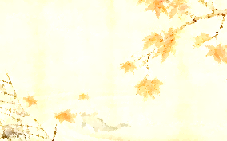
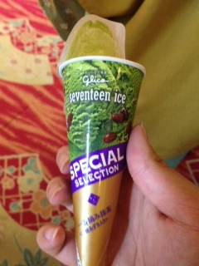
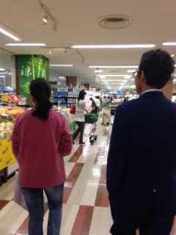
Some Japanese brands unavailable in Australia:
Puchi (Biscuits, cookies etc.), CC Lemon (Soft Drink),
Ramune (Lemonade-like soft drink), Pocari Sweat (Sport drink)
Two Supermarket Chains:
AEON, Daiei
Some Japanese department stores:
Hankyu, ISETAN, Daimaru
Japanese shops and prices:
I find that Japanese shops sell a wider variety of items compared to Australia. However, some things can be very expensive; and conversely some can also be very cheap. I find that Japanese food and grocery sold in shops on the whole are of a decent quality for a reasonable price. Daily items such as stationeries are also of a reasonable price. However, souvenir shops, especially those targeted at foreigners, tend to be very expensive (at least to me).

Slide 8

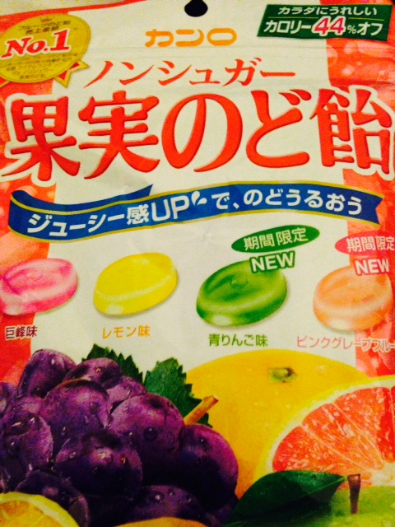
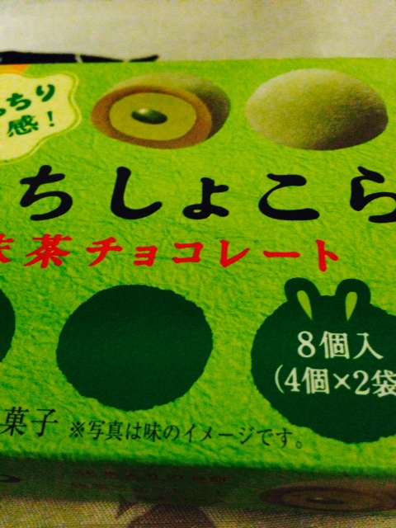
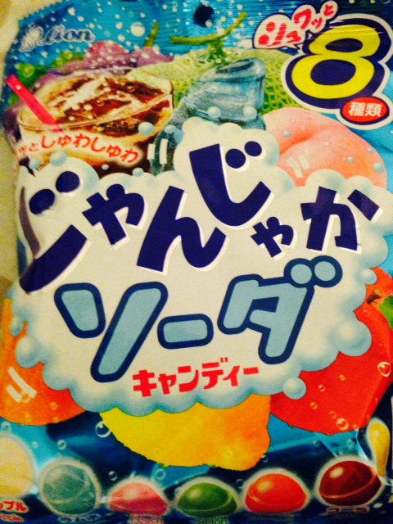
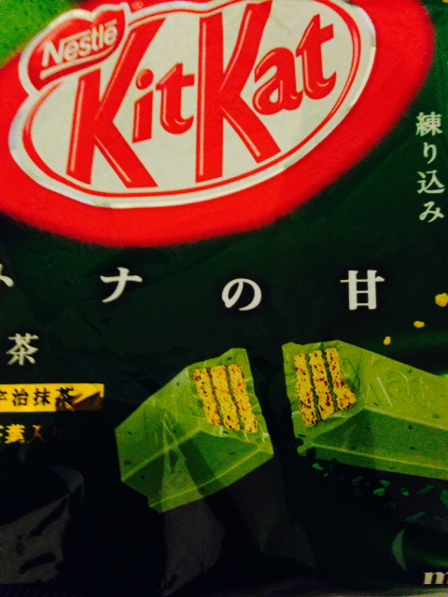
Some packages and wrappers of Japanese food/ snacks:

Slide 9

Recipe for Homemade Spicy Tuna Sushi Roll (by host mum):
Ingredients:
2 cups of sushi rice (for approximately 12-16 pieces)
2-3 nori sheets
150 grams of tuna fillets
1 tablespoon of mayonnaise
1 teaspoon of chili sauce
Method:
Dice tuna into small cubes.
2) Add the mayonnaise and the chili sauce, and mix together with tuna in a bowl.
3) Take half a nori sheet and cover with rice.
4) Flip it over so that the rice is facing down the bamboo rolling mat.
5) With a spoon, make a line of the spicy tuna along the edge of the nori
sheet closer to you
6) Roll it inside-out and cut into 6-8 pieces.
7) Repeat steps 1 to 6 for the other roll.

Slide 10

School:
Teachers: Most of the teachers that I have encountered in my sister-school are very friendly and express a great fascination for foreigners. The teachers that I had for classes are casual in their teaching. However I find that there is not a lot of interactions between teachers and students during classes.
Subjects: All students undertake the same subjects and do not get to choose what “electives” they take. English is a compulsory subject for all students, but they are allowed/ recommended to choose levels of English to study. In addition to English, they also have a class called International Studies and World Studies, in which they conduct studies of global issues. Their history lessons are split into two types: International and local Japanese history. The maths they do is significantly harder in a way that they are not to use calculators and have to work it out manually.
Facilities: I find that the facilities of my sister school are not as “advanced” as what we have in our school, but is equipped with basic facilities such as wooden desks and chairs, fans (no air-conditioning) etc. They do have a specialised computer room, though the computers themselves are of old models. The toilets however are VERY clean.

Slide 11
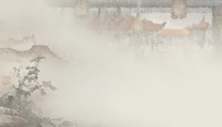
Timetable/ Routine: The class stays in their class for most of their periods unless taking special classes such as Physical Education or World Studies where students move to the computer laboratory. There is a period called homeroom which is similar to our roll call. There is usually a 5 to 10 minute break in between periods for teachers to move around and for students to get up and stretch, or simply chat. School starts at 8:30 and ends at 3:30, and after school students are required to clean their classrooms and the school compound. Then students are also required to go to club activities. After club activities it would usually be around 4:30 to 5 and students usually walk home together and stop by at local convenience stores to get a snack, or even go out for a light dinner together before going home. I also see many students roaming around at night with their friends.
Homework: Japanese students get a fair amount of homework for each subject, however as for my host brother, he told me that some teachers do allow some time in class to get started on homework assigned on the day. He also told me that teachers usually go over the homework the next period. Sometimes, it is also possible that teachers hand out homework sheets as they go through the work, and students are required to complete this “homework” (such as filling in the blanks) as the teacher goes over the content. My host brother usually stays up quite late to finish his homework.
Discipline: From what I see and vaguely know, the discipline in Japanese schools are very good, such as students taking part in souji and cleaning up their classrooms and school, thus the school is always very clean. Students also conduct themselves in a very well-manner. I have not witnessed any disciplinary actions during my day at the high school.

Slide 12

Culture:
What I think is unique about the Japanese culture that is different to the typical Australian lifestyle is the family unit. Unlike Australian families, the role of each member of the family unit is very distinct. For example, the mother usually stays at home and does the domestic roles, while the father is out working till late hours.
Though not as common in Australia, It also seems to be typical for school-children have tutoring at “cram schools” in addition to their long day at school, so that they are able to learn more ahead of their peers. Thus, it feels like the Japanese education system is very rigorous and highly-competitive.
I do find that Japanese people are very obsessed with Caucasian foreigners, especially those with blonde hair and blue eye foreigners. Because Australia is a very multicultural country, the popularity and royalty that “white-skinned” foreigners receive in Japan is very shocking to me, and to a certain extent very creepy.
I also feel like Japanese people distinctly have “two-sides”, one in public and one in private. This is more prominent in those working in the public sector which deals with customers. Although the customer service is very good, I somehow feel like it is not sincere and is like a “fake façade” masked in front of customers.

Slide 13

Personal Experiences, Interesting excursion:
We were on an excursion to the Osaka Castle; yet the trip was filled with many distractions that were mainly dogs. Before entering the Castle itself we were distracted by two Hachi dogs, and that easily took us ten minutes of playing and petting the dogs. I could see that our tour guide was feeling the pressure to be on time. Once we entered the castle we were once again caught in the middle of a movie being filmed. Many of us wanted to wait so that we could take photos with the characters attired in ancient Japanese costumes. Personally I felt a bit tired of waiting and it took us ten minutes just to wait for the filming to end. Finally we were approaching closer to the castle itself, only to be distracted by two more dogs for another ten minutes. Up to this point the tour guide was very frustrated and had to hurry us into the castle. Upon entering we were only given a short amount of time to observe the seven-floors of exhibition as a lot of time was solely spent outside. There was a long queue to the elevator so all of us had to take the stairs. Chris, Harsheen, Nicole and I decided to take the stairs all the way up to the seventh floor and would slowly make our way down the other floors of exhibitions. Secretly hoping to be first up to see the view of Osaka city, we ran our way to the top only to find that we were one of the last to reach. Breathless, we could only spend such little time to observe the busy but nonetheless beautiful view of Osaka city.

Slide 14
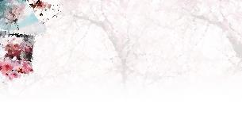
Funny incident:
At Osaka, we thought it would have been nice for us to go out for dinner as a group. With our limited Japanese and poor interpretations of directions, it took us half an hour to walk to a ramen shop that was only ten minutes away. I noticed that the area was not as hygienic as the areas we passed by as we were walking, and had a lot of flashy signs. This place was “dodgy”, to say the least. Because I was hungry and we were rushing to get dinner, I paid no attention to the signs or bothered to read the hiragana/ katakana. After finishing dinner we came out of the shop and started to noticed a lot of males and females with very flamboyant hair and exotic fashion. Passing by the flashing signs again I now took the opportunity to read the signs. Only did I find out that this place was a little red-light area as the signs read “Men’s Relaxing Place, prices listed below”.
The story continues as we also passed by a pachinko parlour. Those like me who did not have a pachinko ball for the pachinko challenge were desperate to get some, only to find that security guards had already been eyeing on us. Lucky for me, while buying a drink from a vending machine, pachinko balls were scattered across the ground; however Hamish decided to run in the place and grabbed a few pachinko balls, making a big escape afterwards.

Slide 15
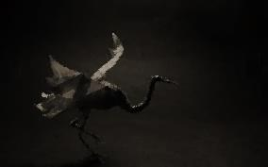
School lesson:
For the English conversation class, the teacher thought it would be a great idea for Daanish, Harsheen and myself to teach the class about Australia. Being the great leader he believed to be I could tell Daanish was getting very excited and took the lead in teaching the class about Australia. Though it started off entertaining, Daanish derailed from the Australian culture and attempted to teach geography and history of Australia. At this point of time, I could see a lot of the students were getting bored and some even started to doze off, in which Harsheen and I tried to politely ask Daanish to change the topic. Daanish however, decided to go on and on, and even the teacher was reluctant had kept forcing out a smile.
Daanish also attempted to teach the students Australian slang; which although sparked some interest, was yet another awkward situation for myself when I had to force out an unnatural “bogan” accent. Daanish also began to talk about the (slightly inappropriate) things such as talking about Lebanese people in Sydney. Harsheen and I once again tried to change the topic, but was unable to triumph over Daanish’s passion as a teacher, leaving us in very awkward situations of standing in front of the classroom and doing nothing but to smile.
The class felt like the phrase “sure, mate” very amusing. When asked to ask us questions, none of the students raised their hands, much to the dismay of the greatest teacher, Daanish.

Slide 16

Most Frequently and Learned Words/ Phrases：
ならんでください Please Line Up
お客様 Guest/ Customer
お待たせしました Thanks for waiting
いっらしゃいませ Welcome!
何名様ですか How many people
やばい So sick! (slang)
行ったことがありますか Have you been to …
すげえ Amazing (slang version of すごい）
冷凍 Frozen
疲れた Tired
うちわ Hand-held fan
めっちゃVery
超 Very
丘 Hill
宮殿 Palace
Some Shops/ Places in the Local Area:
Daiso, AEON, Daiei, “Taiwan Ryouri”, UNIQLO, Yaki Lucky (Yakiniku Restaurant)

