Slide 1

Stage 5 Subject Selection
2025 - 2026
Cherrybrook Technology High School
Presented by Mr. Gary Monahan
Head Teacher – Stage 5

Slide 2

Acknowledgement to Country

Slide 3

NSW Education Standards Authority (NESA) Requirements

Slide 4
Record of School Achievement (RoSA)
  All students that successfully complete Year 10 but do not go on and complete their HSC will receive a RoSA.
  A RoSA provides an ongoing, cumulative record of student achievement.
  The grades for courses completed in all of Stage 5 (Year 9 and 10) will contribute to the grade given at the end of Year 10.
  Grades are allocated according to NESA Course Performance Descriptors.
  RoSA’s can potentially be used for early entry to university and for scholarship applications.
  More information can be found at: https://educationstandards.nsw.edu.au/wps/portal/nesa/11-12/leaving-school/record-of-school-achievement

Slide 5
HSC Literacy and Numeracy Minimum Standards Testing
  During Year 10, 11 and 12 students will be given the opportunity to complete the 3 minimum standards tests:
    Reading
    Writing
    Numeracy
  National Assessment Program – Literacy and Numeracy (NAPLAN) is no longer used as a minimum standards test and will be used as per its original purpose as a diagnostic tool to track students progress and identify students that require additional assistance.
  More information can be found at: https://educationstandards.nsw.edu.au/wps/portal/nesa/11-12/hsc/hsc-minimum-standard

Slide 6

Cherrybrook Technology High School - Stage 5 Requirements

Slide 7
Stage 5 (Year 9 & 10) Subjects
  By the end of Year 10 students will have completed:
    English – 200 hours
    Mathematics – 200 hours
    Science – 200 hours
    PDHPE/Sport – 200 hours
    Geography – 100 hours
    History – 100 hours
    Vocational Education – 50 hours
    Elective Courses Units – 700 hours (14 semester courses)

Slide 8
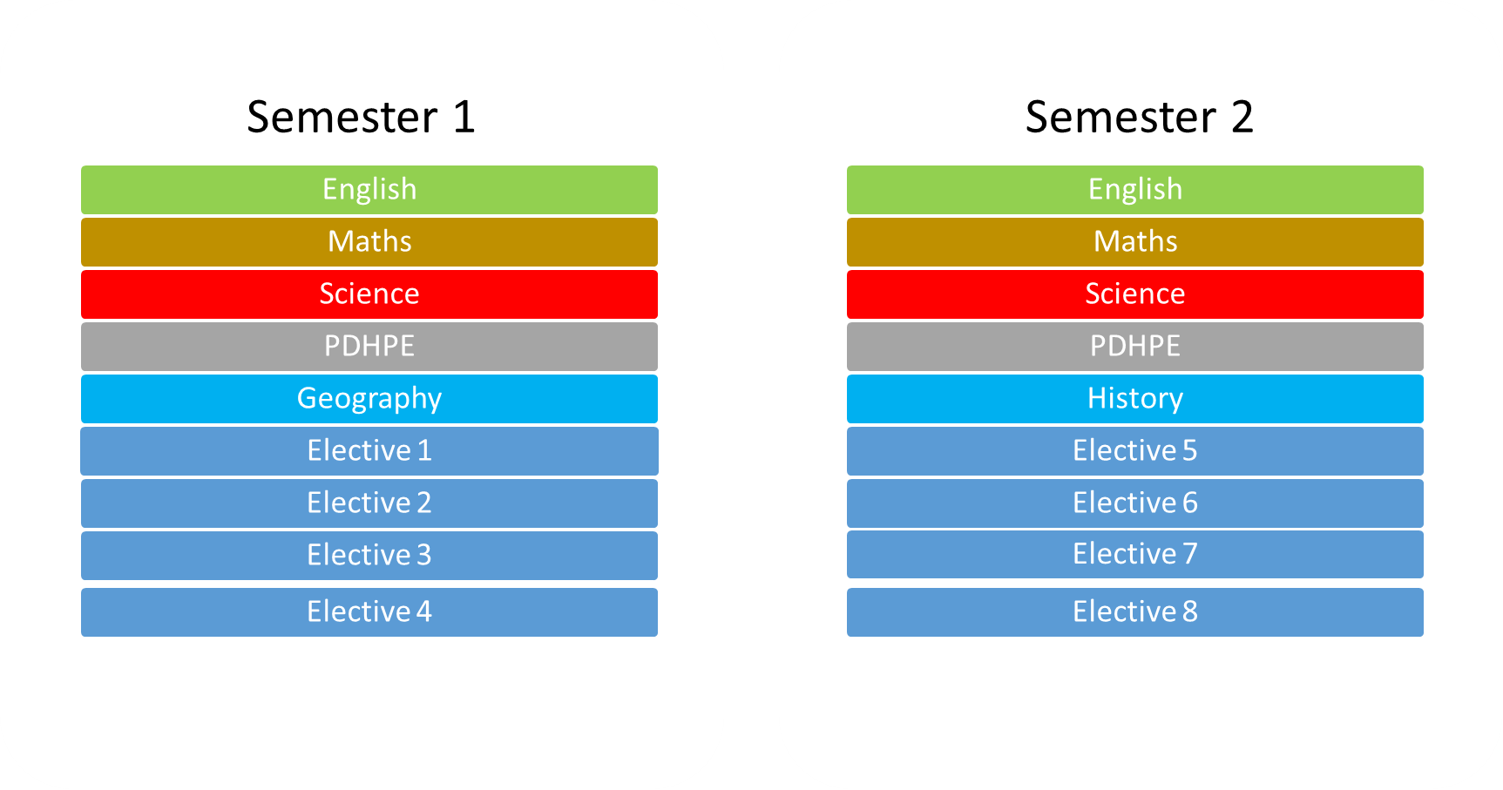
Year 9 Subjects

Slide 9
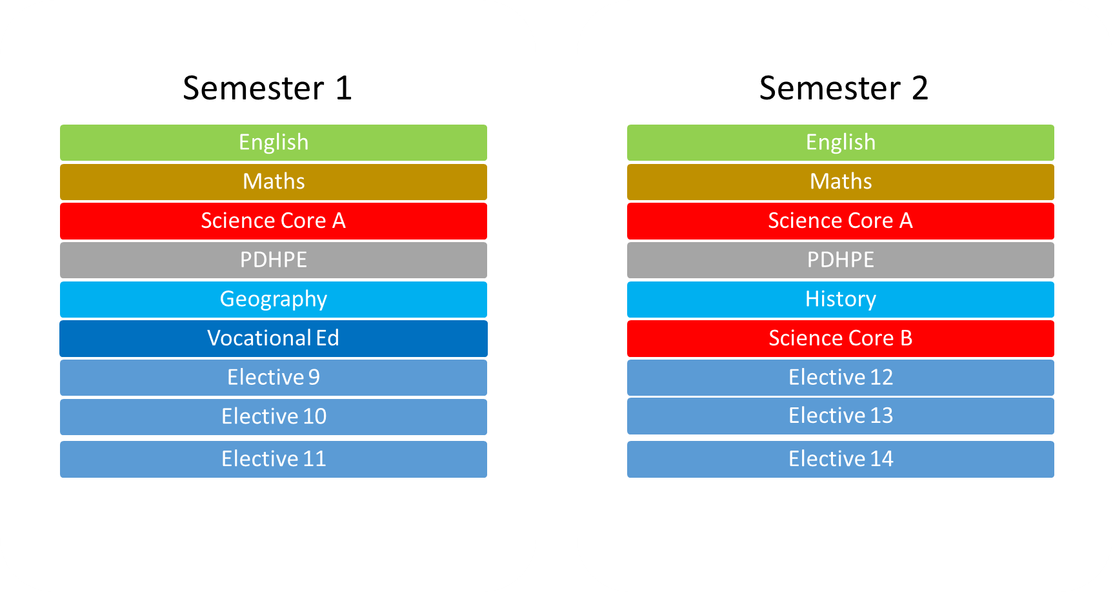
Year 10 Subjects

Slide 10
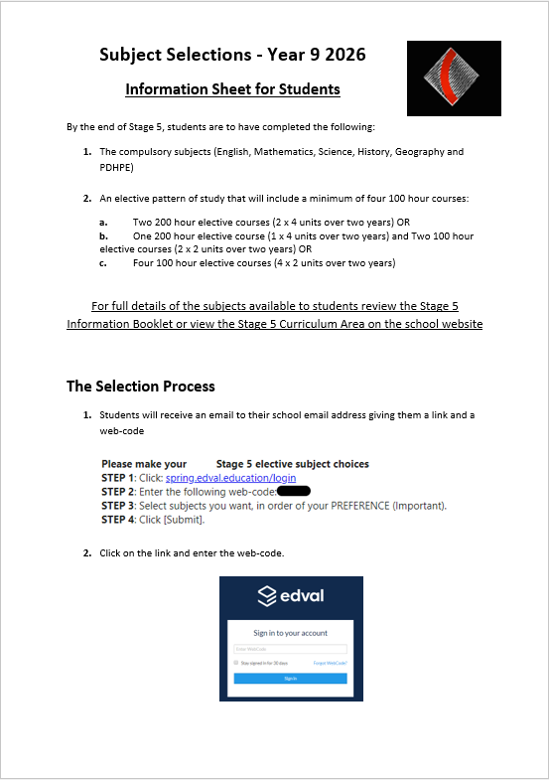

Choosing Subjects

Slide 11

Elective Subjects
  Elective subjects are broken down into sections.
  For example:
    Key Learning Areas (KLA’s):
    NESA Courses:
      Dance
      Drama
      Music
      Visual Arts
      Photography

Slide 12
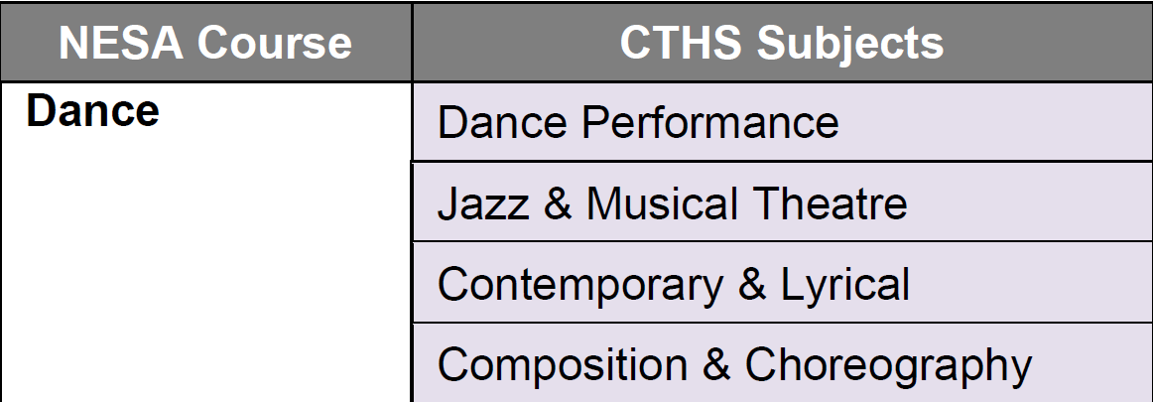
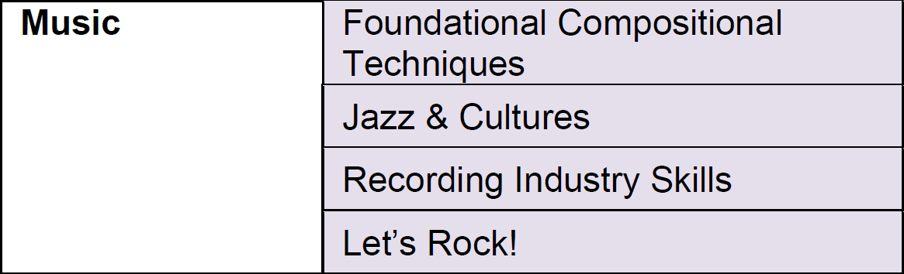
    CTHS Subjects run for one semester and are equal to 50 hours of study.

Slide 13
  You need to achieve a minimum of 400 hours of Elective – NESA Courses by the end of Year 10.
    This can be achieved by:
      2 x 200-hour courses
      1 x 200-hour course and 2 x 100-hour courses
      4 x 100-hour courses
  Students receive a grade (A – E) for the following subjects:
    English
    Mathematics
    Science
    PDHPE
    History
    Geography
    Any Elective - Curriculum Course that students obtain 100 hours (2 Course Units) or 200 hours (4 Course Units) over Year 9 and 10 combined.

Slide 14
An Example
  A student wishes to study the following NESA Courses across Stage 5
    200 hours of Industrial Technology – Timber
    100 hours of Japanese
    100 hours of Physical Activity and Sports Studies

Slide 15
  They would choose the following Course Units:
    Industrial Technology – Timber
      General Wood 1 (TW1)
      General Wood 2 (TW2)
      General Wood 3 (TW3)
      General Wood 4 (TW4)
    Japanese
      Japanese Level 3 (LJ3)
      Japanese Level 4 (LJ4)
    Physical Activity and Sports Studies
      Sports Coaching (PSC)
      Sports Fitness (PSF)

Slide 16
Year 9 Subjects
Semester 1
English
Japanese Level 3
Semester 2
English
Maths
Japanese Level 4
Science
PDHPE
History
General Wood 2
General Wood 1
Maths
Science
PDHPE
Geography
Elective
Elective
Sports Fitness
Elective

Slide 17
Year 10 Subjects
Semester 1
English
General Wood 3
Semester 2
English
Maths
General Wood 4
Science Core A
PDHPE
History
Science Core B
Vocational Ed
Maths
Science Core A
PDHPE
Geography
Sports Coaching
Elective
Elective
Elective

Slide 18
  This plan of study will meet the NESA requirements as it has the minimum of 400 hours of Elective – Course Units.
  However, there are still 6 Elective – CTHS Subject spots available for this student to select. These can be filled by selecting one-off subjects of interest or completing additional units in Japanese or Physical Activity and Sports Studies.

Slide 19
  Further Information:
    All mandatory subjects will be automatically chosen for you.
    You are only selecting CTHS Subjects for 2026 - Year 9.
    You will need to select 10 CTHS Subjects, in preference order.
    You will complete 8 CTHS Subjects in 2026, the other two are reserves in case subjects are full or do not run due to lack of numbers.
    Please be aware of Curriculum Courses with prerequisites. You will need to complete Course Units 1 & 2 in Year 9 before completing 3 & 4 in Year 10.
    Please note some courses have fees that are compulsory.
    You will complete the selection process again next year for Year 10. Please note that you can’t select the exact same CTHS Subject unit in Year 9 and 10.
    The following School Developed Courses have been NESA approved but do not count as Curriculum Courses for the RoSA:
      English Elective
      Mathematics Elective
      Literacy Workshop

Slide 20
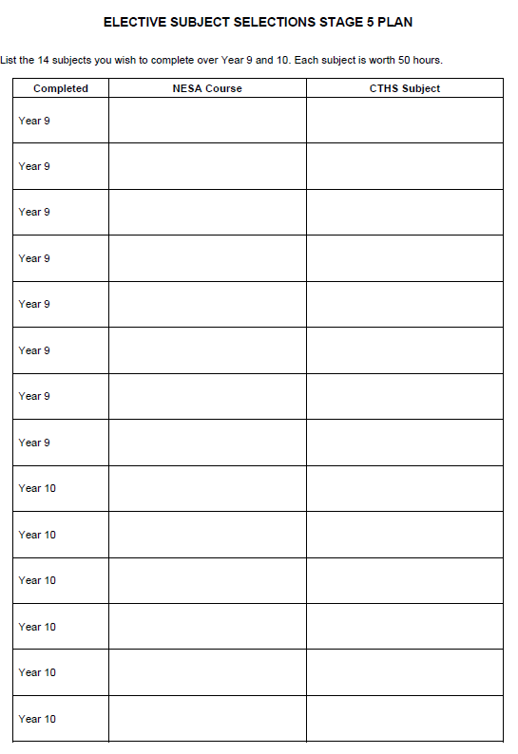

Slide 21
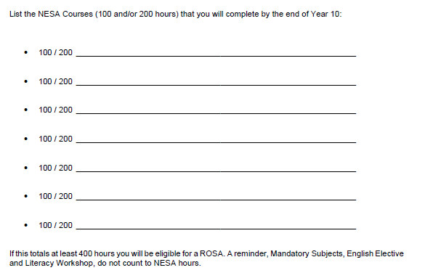

Slide 22
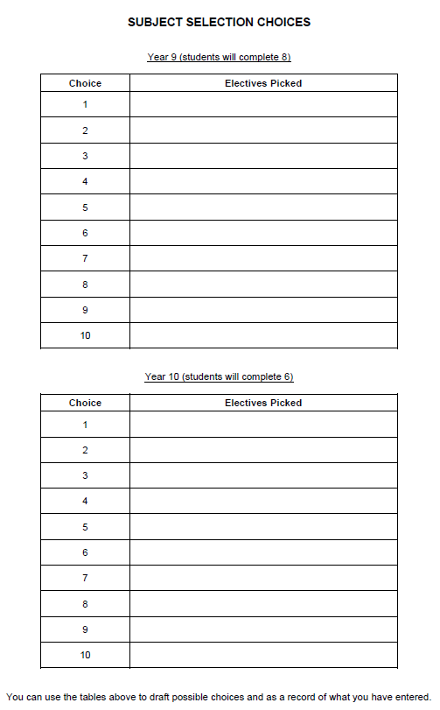

Slide 23
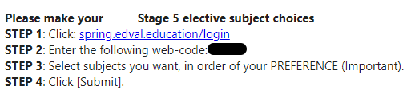
The Selection Process
1. Students will receive an email to their school email address giving them a link and a personalised web-code.

Slide 24
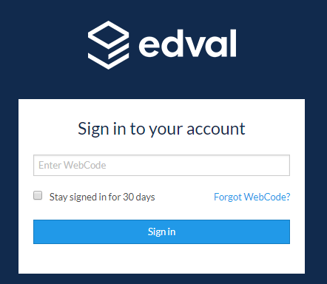
2. Click on the link and enter the personalised web-code.

Slide 25

3. Choose the Stage 5 Elective 2026 option.

Slide 26
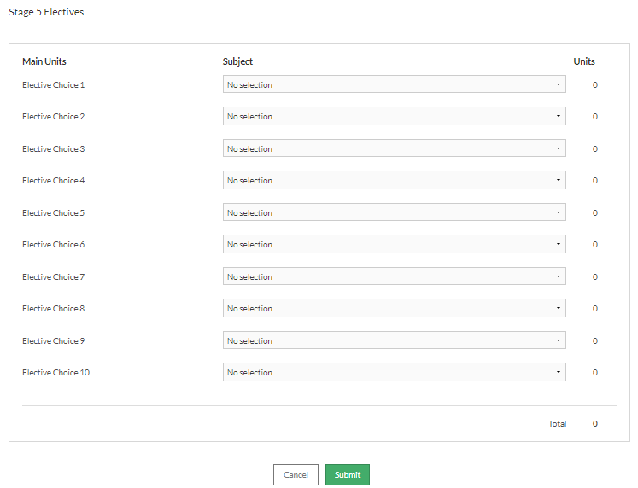
4. You will then be on a screen where you choose 10 electives for 2025. Place your choices in preference order.

Slide 27
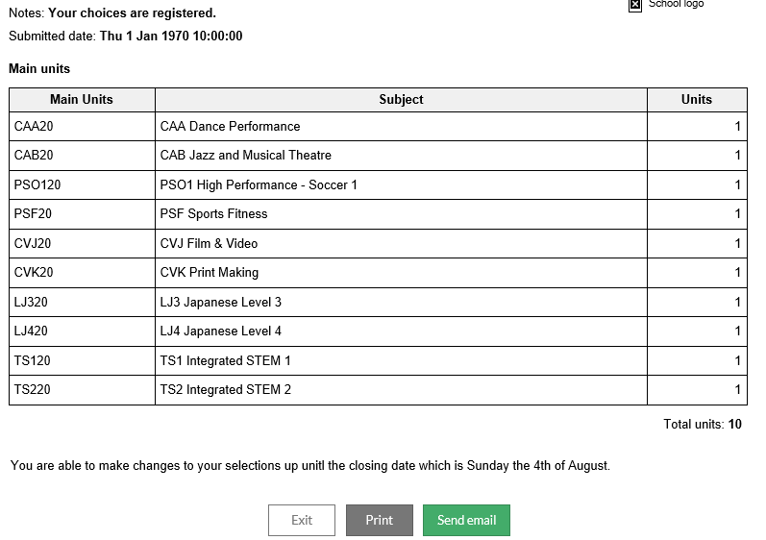
5. Press submit and either print or make a note of the electives that have chosen.

Slide 28
Important dates:
  Online selections open – Monday 30 June at 4pm
  Online selections close – Sunday 24 August at 10pm
Where to get more information:
  Stage 5 Head Teacher – Mr Gary Monahan
    gary.monahan@det.nsw.edu.au
  Year Advisors – Miss Jessica Morgan & Mr David Oksinski
    Jessica.morgan34@det.nsw.edu.au
    David.oksinski@det.nsw.edu.au
  Careers Advisors – Mrs Frankie Arroyo
    franchesca.arroyo@det.nsw.edu.au
  KLA Head and Classroom Teachers

Slide 29
Suggestions
Plan your Year 9 and Year 10 CTHS Subjects before submitting your Year 9 selections.
Remember you do not need to get all 400 hours completed in Year 9 and hours carry over to Year 10.
However, if possible try and obtain at least 3 x 100 hour NESA Courses in Year 9. This allows greater flexibility for subject choices in Year 10.
Avoid picking 4 CTHS Subjects (200hrs) from the same NESA Course in Year 9. This will limit the ability to choose subject from that area in Year 10.

Slide 30
FAQ’s:
Question 1) Does CTHS have any graded/accelerated/streamed classes?

Slide 31
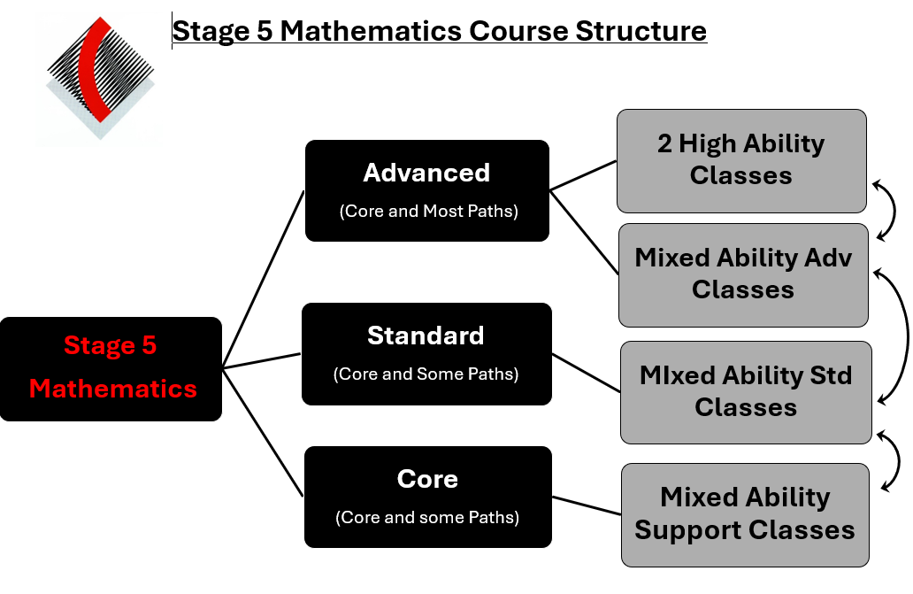
Mathematics

Slide 32
Science:
  2 top classes (1 on each line)
English:
  1 top class
  1 all Boys and 1 all Girls class
Visual Arts:
  VA GATs Class (Year 10 only). Applications at the end of Year 9
Aboriginal Studies:
  Accelerated HSC Course in Year 10/11. Application at the end of Year 9

Slide 33
Question 2) Do these selections affect Year 11/12 subjects?
  No. The only subject that it has any impact is Languages. It affects the ability to select Continuers rather than Beginners

Slide 34
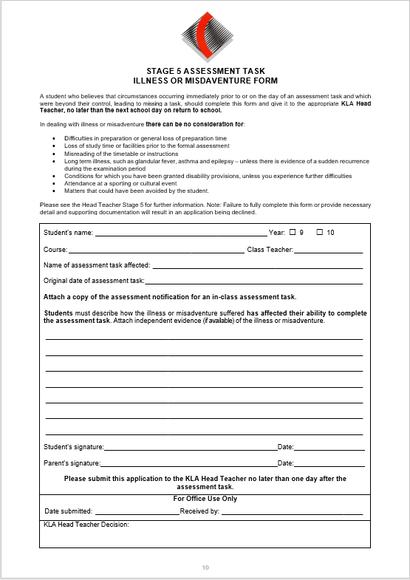
Question 3) Are there any differences in assessment procedures?

Slide 35
Questions
If you have any questions about NESA requirements or the selection process see me out the front or if they are subject specific please see the KLA representatives now.
Alternatively feel free to email gary.monahan@det.nsw.edu.au after the session

Slide 36
Year 8 into 9 Information Evening Table Map
Stage
PDHPE
CAPA
HSIE
TAS
LOTE
SCIENCE
MATHS
ENGLISH
IT

